Slide 1
Extending Kubernetes API
API Server, custom API and custom resources

Slide 2

Objectives
Understand how to extend Kubernetes API
Application of extensions
Look at real some world examples of extensions

Slide 3
Overview
Part 1
Part 2
Intro into API Server (core API and structure, discovery API)
Extending the API Server with a custom API via APIService
Accessing the API Server via client libraries
Custom Resource Definitions (CRDs)
CRD controllers
Kubernetes operator library
Using Helm

Slide 4
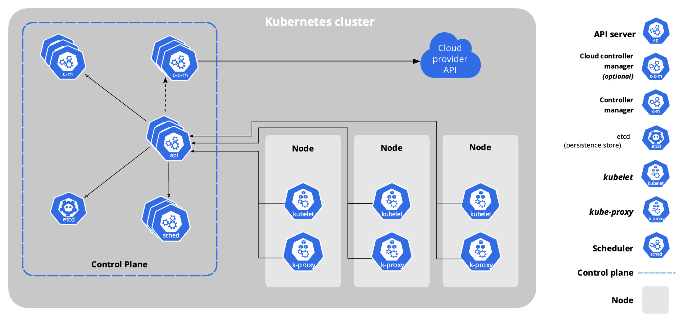
Kubernetes components
https://kubernetes.io/docs/concepts/overview/components/

Slide 5
API Server
Provides (mostly) REST API.
Exceptions: health checks.
Communicates with ETCD
Handles all in-cluster communication
API server gives access to the Kubernetes resources
and non-resource objects.

Slide 6
Kubernetes resources
Objects managed by Kubernetes:
pods, services, deployments
From Kubernetes docs:
”A resource is an endpoint in the Kubernetes API that stores
a collection of API objects of a certain kind; for example, the built-in pods resource contains a collection
of Pod objects”

Slide 7
Kubernetes non-resource objects
Metrics
Logs

Slide 8
Requests to API Server
kubectl get pods –v 6
kubectl proxy
kubectl get --raw
kubectl cluster-info
kubectl api-versions

Slide 9
Kubernetes API Groups
/api
/apis
/healthz, /livez, /readyz
/metrics

Slide 10
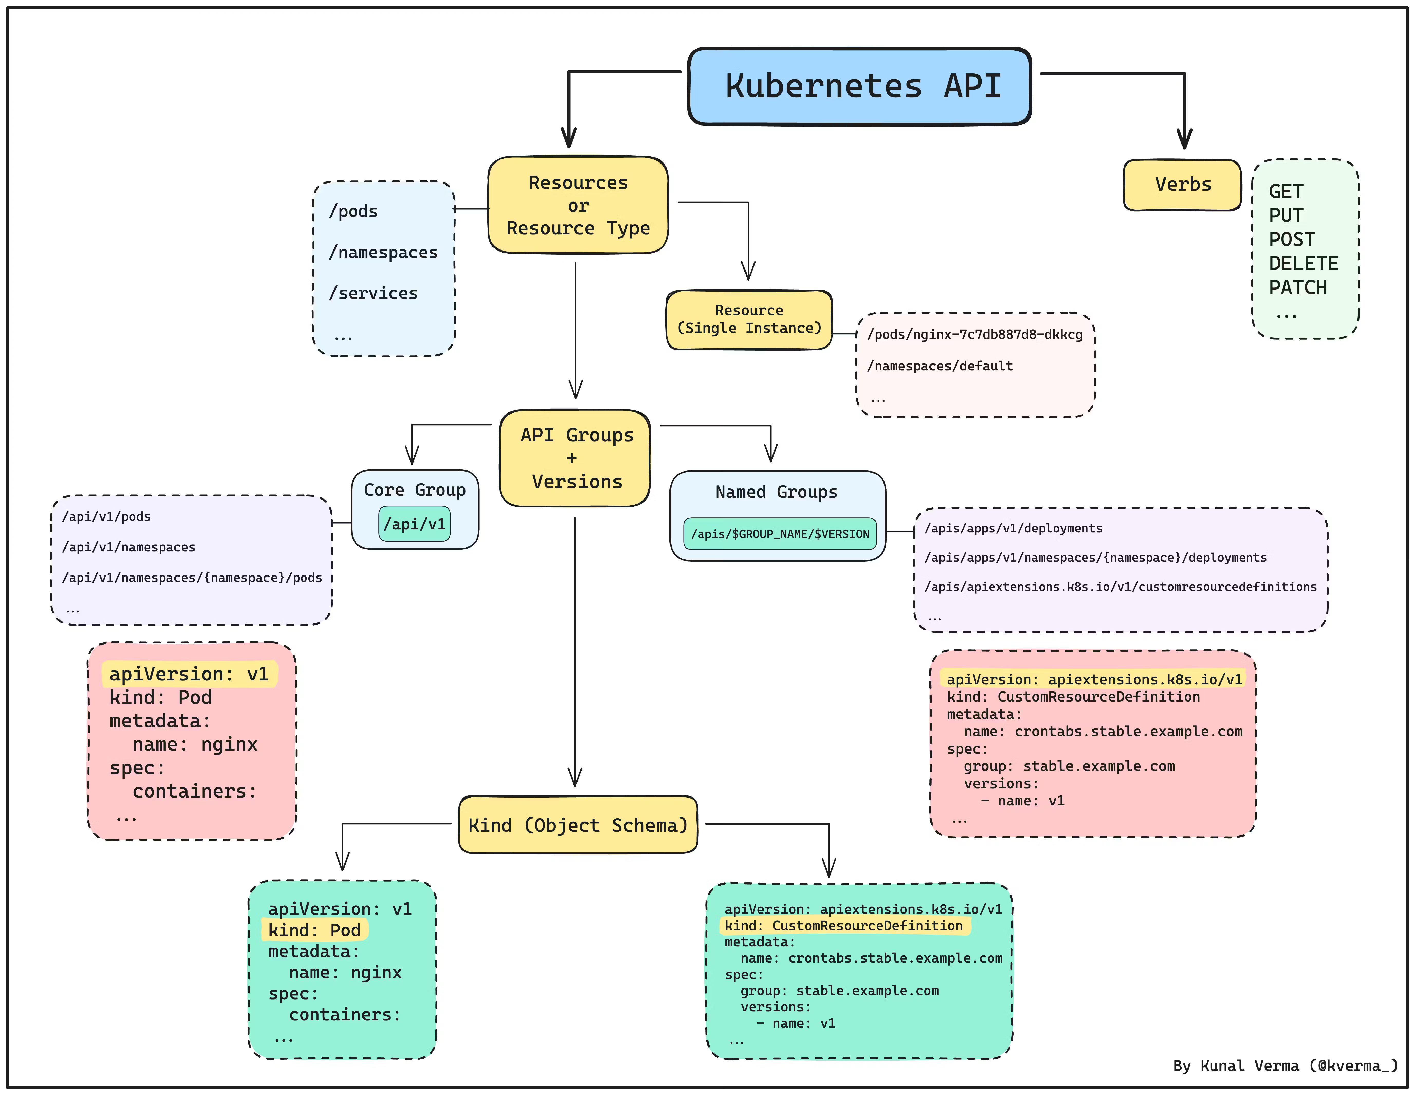
Kubernetes API structure

Slide 11
Discovery API
a special API that gives information
about the API groups and versions available in the cluster

Slide 12
Extending Kubernetes API: Aggregation layer
When enabled, allows to register extensions

Slide 13
APIService
apiVersion: apiregistration.k8s.io/v1 kind: APIService metadata: name: v1alpha1.example.com spec: service: name: api-extension-server namespace: default group: example.com version: v1alpha1 insecureSkipTLSVerify: true groupPriorityMinimum: 1000 versionPriority: 15

Slide 14
APIService: use case
Metrics + Autoscaling (HPA)
Metrics types:
Resource metrics
Custom metrics
External metrics

Slide 15
HorizontalPodAutoscaler
apiVersion: autoscaling/v2 kind: HorizontalPodAutoscaler metadata: name: php-apache spec: scaleTargetRef: apiVersion: apps/v1 kind: Deployment name: php-apache minReplicas: 1 maxReplicas: 10 metrics: - type: Resource resource: name: cpu target: type: Utilization averageUtilization: 50
Resource metrics: /apis/metrics.k8s.io/v1beta1/…
Custom metrics: /apis/custom.metrics.k8s.io/v1beta2/…
External metrics: /apis/external.metrics.k8s.io/v1beta1/…
https://kubernetes.io/docs/tasks/run-application/horizontal-pod-autoscale-walkthrough/

Slide 16
Metrics API + APIService
Metrics API interfaces to implement:
metrics API,
custom-metrics-apiserver
Existing implementations examples:
Metrics server
Prometheus adapter

Slide 17
APIService
apiVersion: apiregistration.k8s.io/v1 kind: APIService metadata: name: v1alpha1.example.com spec: service: name: api-extension-server namespace: default group: example.com version: v1alpha1 insecureSkipTLSVerify: true groupPriorityMinimum: 1000 # Kubernetes uses this to resolve conflicts when multiple API groups serve the same resource. A higher value means higher priority. versionPriority: 15

Slide 18
Metrics server components
apiVersion: apiregistration.k8s.io/v1 kind: APIService metadata: labels: k8s-app: metrics-server name: v1beta1.metrics.k8s.io spec: group: metrics.k8s.io groupPriorityMinimum: 100 insecureSkipTLSVerify: true service: name: metrics-server namespace: kube-system version: v1beta1 versionPriority: 100

Slide 19
Next steps
https://github.com/ybaryshnikova/extensions-meetup/tree/master/apiservice-example
Follow the metrics tutorial (link in references)

Slide 20
References
Kubernetes API guide
Kubernetes Python client custom API Working with Kubernetes API Series Metrics server tutorial

Slide 21
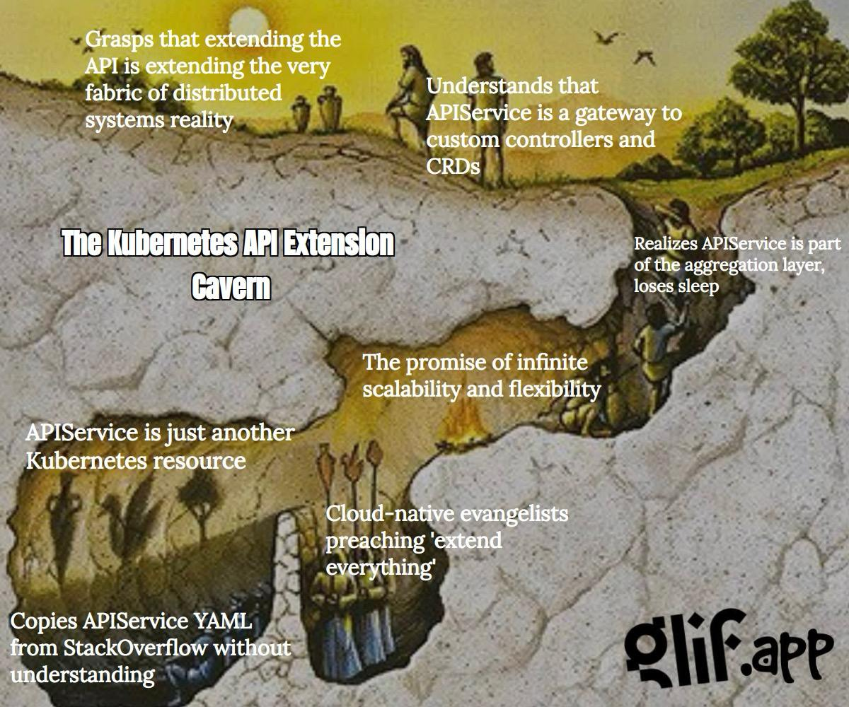
Fine art

Slide 22
Questions?

